Slide 1


Slide 2

Agenda
Tools
Questions?
Lab
https://cyberdefenders.org/blueteam-ctf-challenges/35

Slide 3
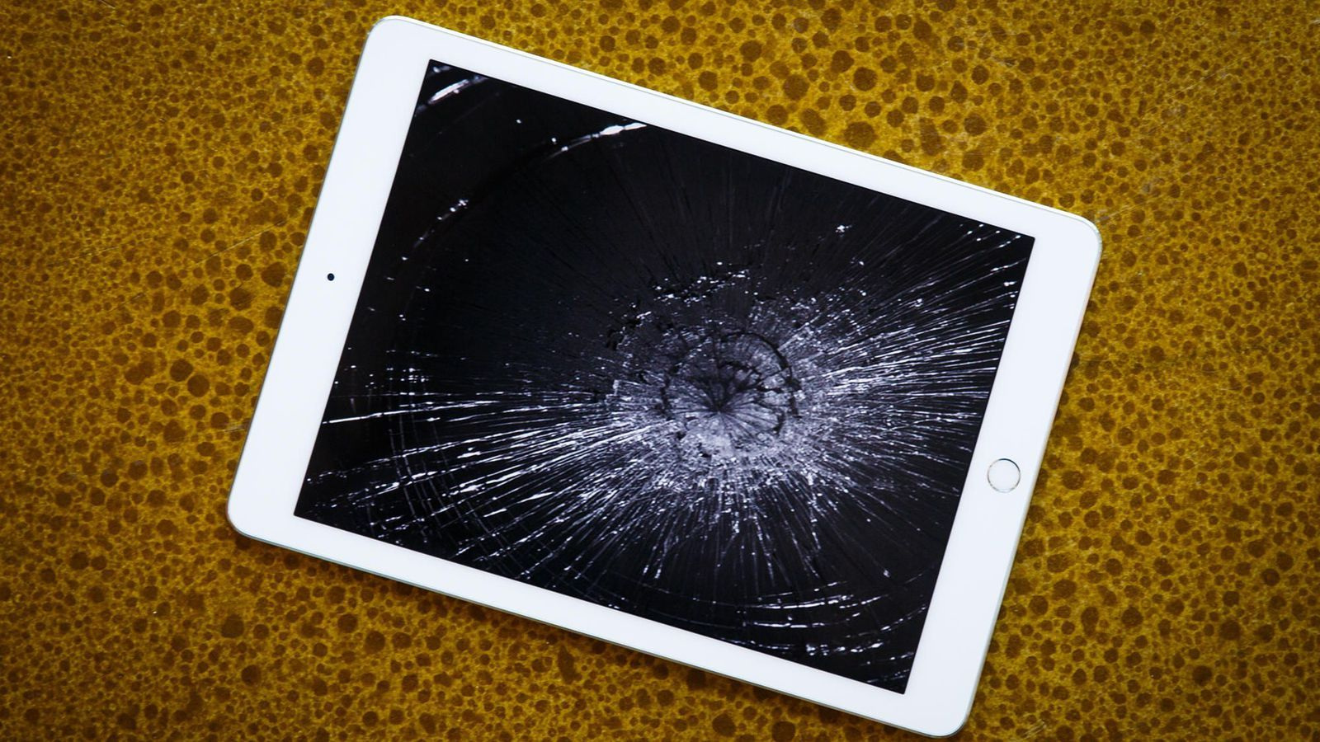
JailBroken

Slide 4


JailBroken
https://cyberdefenders.org/blueteam-ctf-challenges/35
So…
We’ll be working with the HTML report

Slide 5

Tools
Autopsy
is an easy to use, GUI-based program that allows you to efficiently analyze hard drives and smart phones. It has a plug-in architecture that allows you to find add-on modules or develop custom modules in Java or Python
iLEAPP
iOS Logs, Events, And Plists Parser

Slide 6
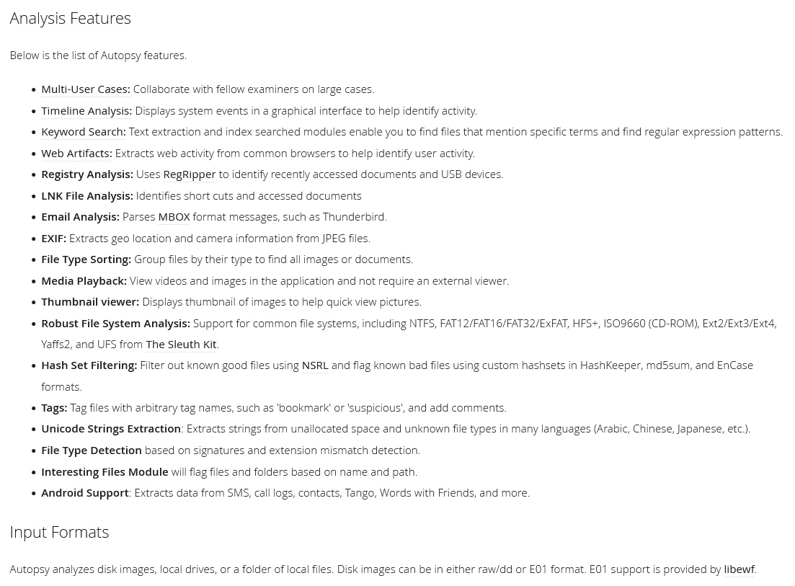


Slide 7
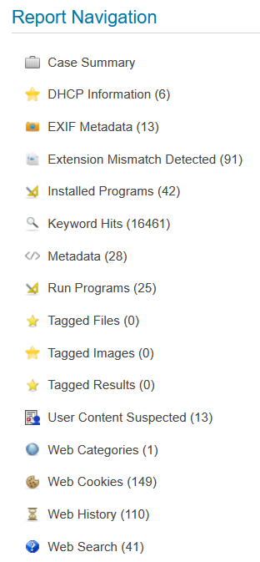

Slide 8
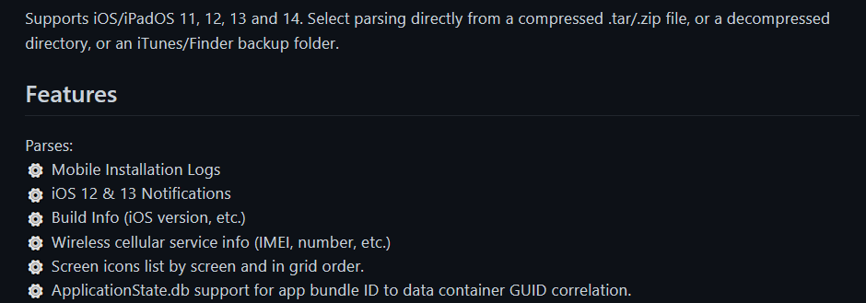
iLEAPP
https://github.com/abrignoni/iLEAPP

Slide 9
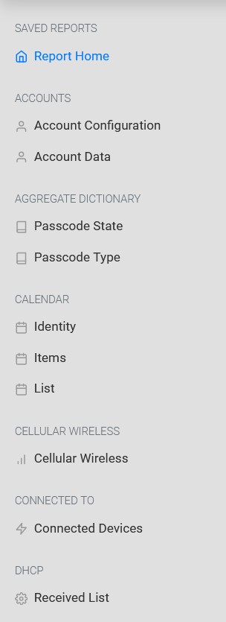
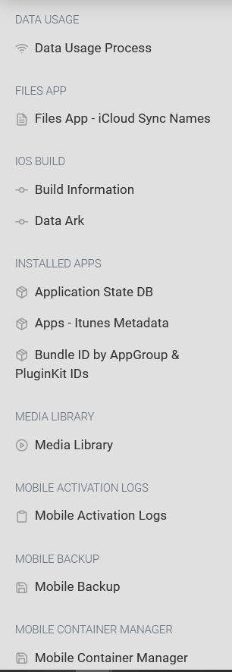
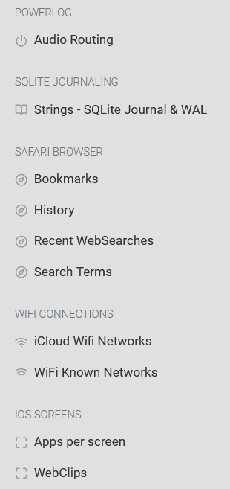
iLEAPP
HTML Report fields

Slide 10
Lab @ https://cyberdefenders.org/blueteam-ctf-challenges/35
Requires access to web browser
Under ‘Practice’ tab, Search ‘JailBroken’
https://blueteamlabs.online/home/investigation/32

Slide 11
Question 1
What is the IOS version of this device?

Slide 12
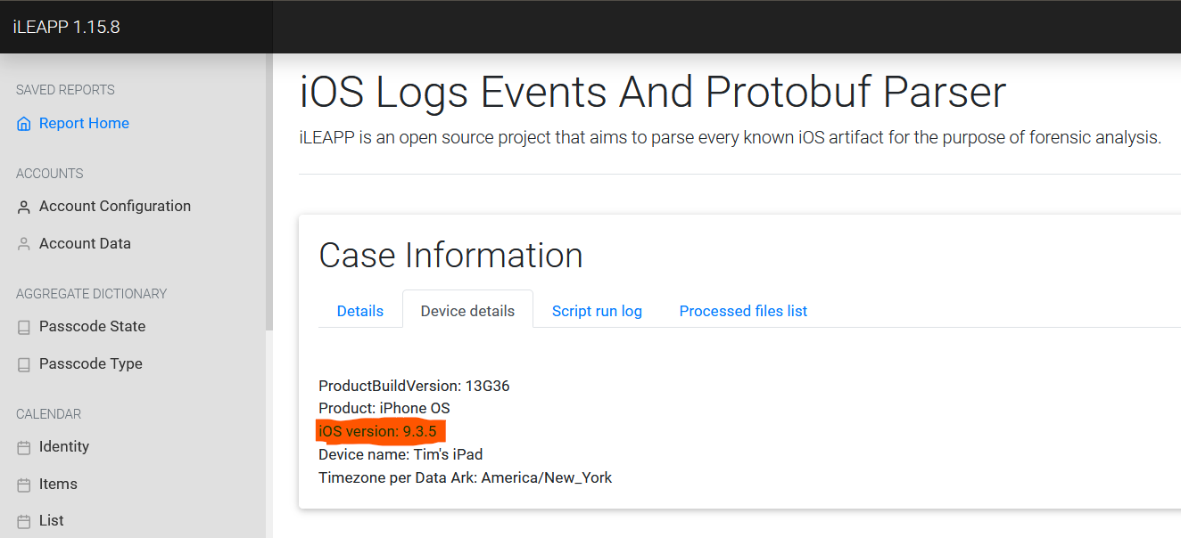

Slide 13
Question 2
Who is using the iPad? Include their first and last name. (Two words)

Slide 14
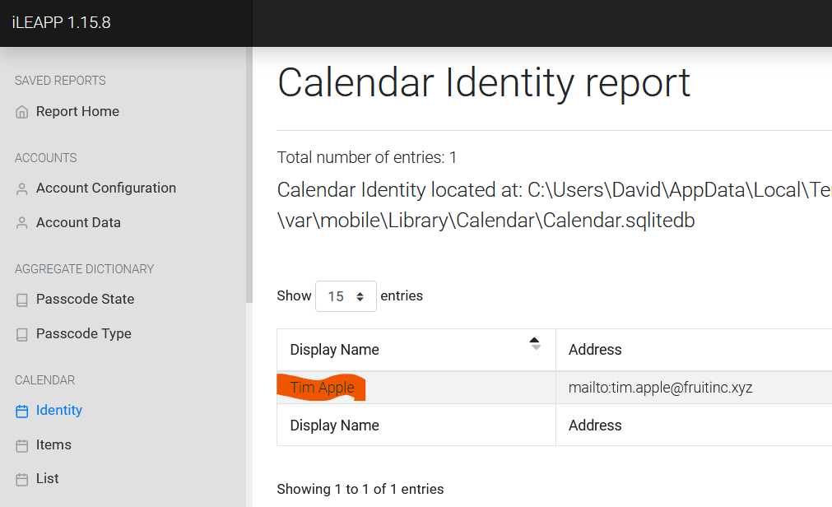

Slide 15
Question 4
What is the title of the webpage that was viewed the most? (Three words)

Slide 16
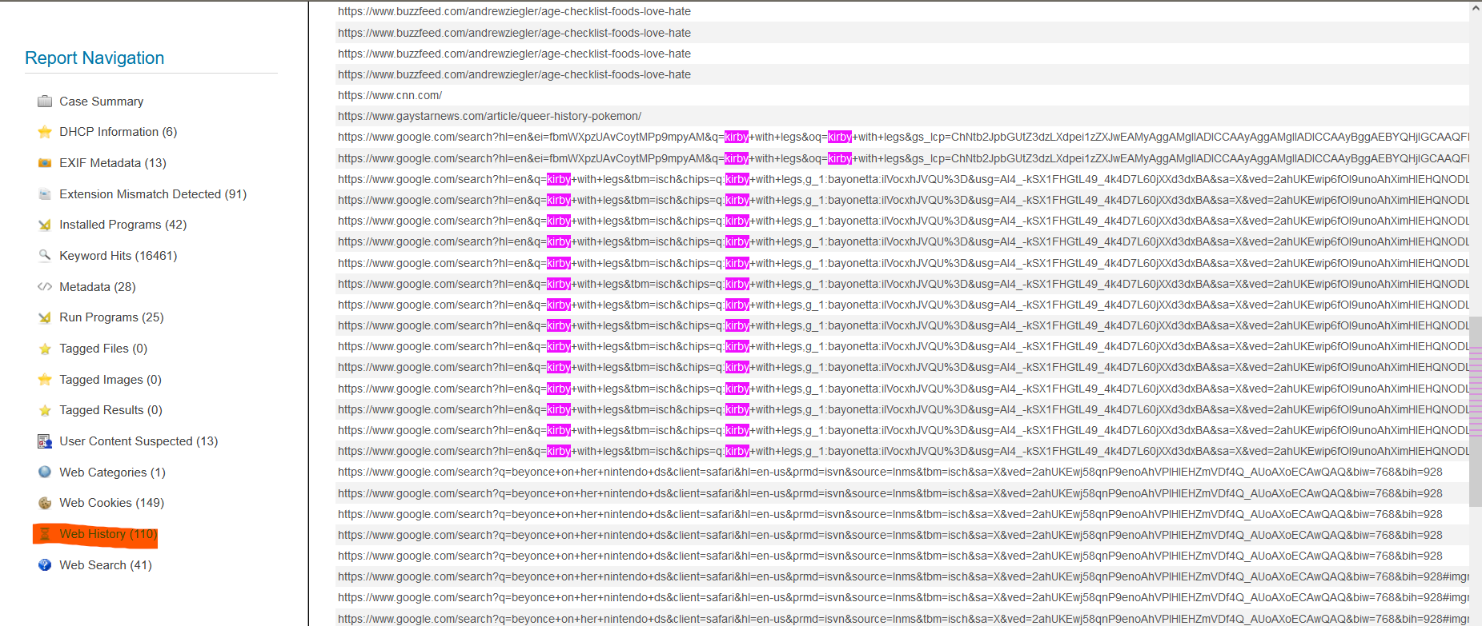

Slide 17
Question 6
What is the name of the WiFi network this device connected to? (Two words)

Slide 18
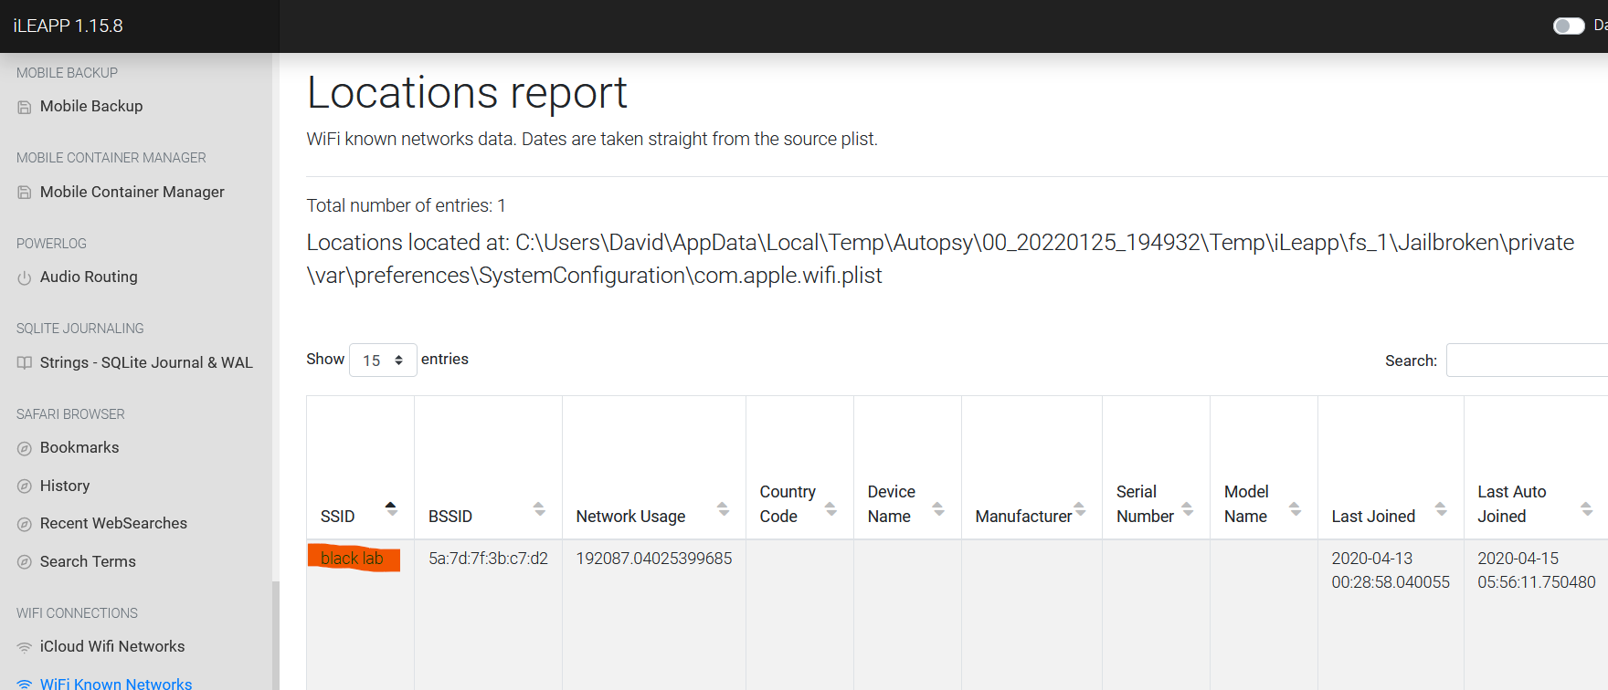

Slide 19
Question 9
What was the first app download from AppStore? (Two words)

Slide 20
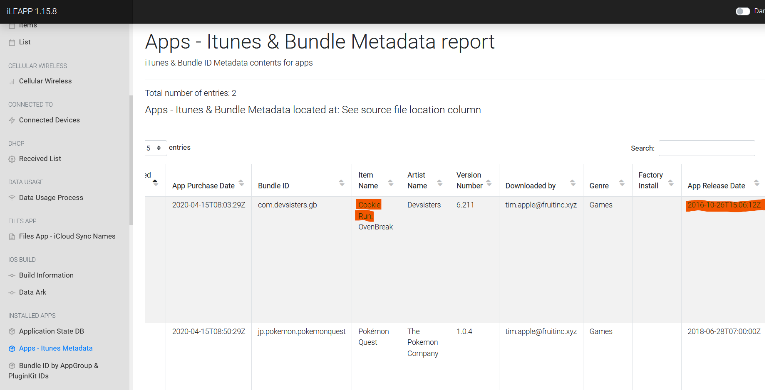

Slide 21
Question 11
How many applications were installed from the app store?

Slide 22
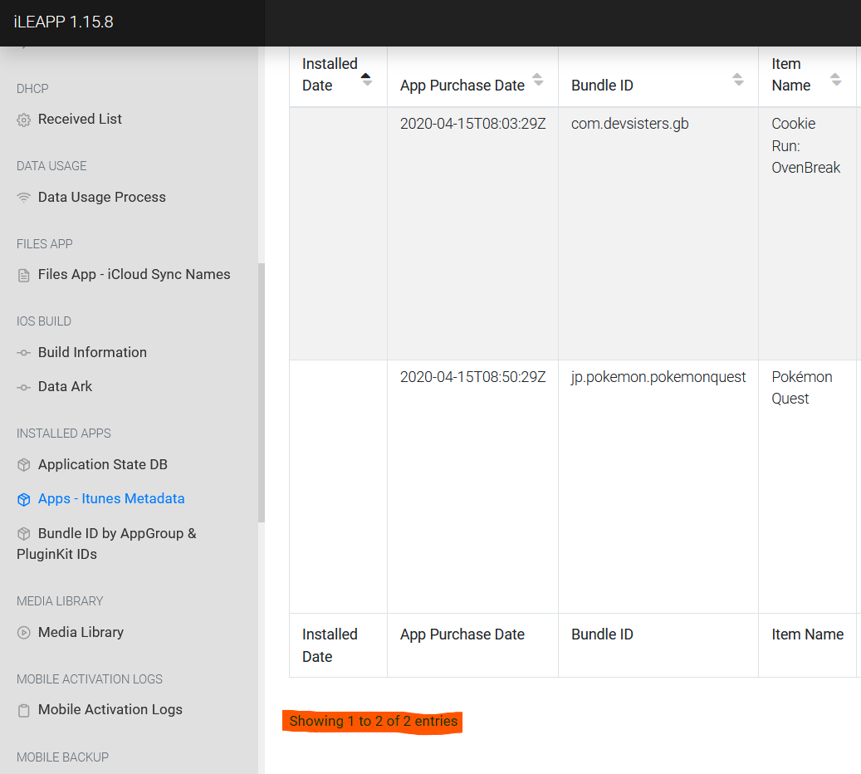

Slide 23
Question 16
There was an SMS app on this device's dock. Provide the name in bundle format: com.provider.appname

Slide 24
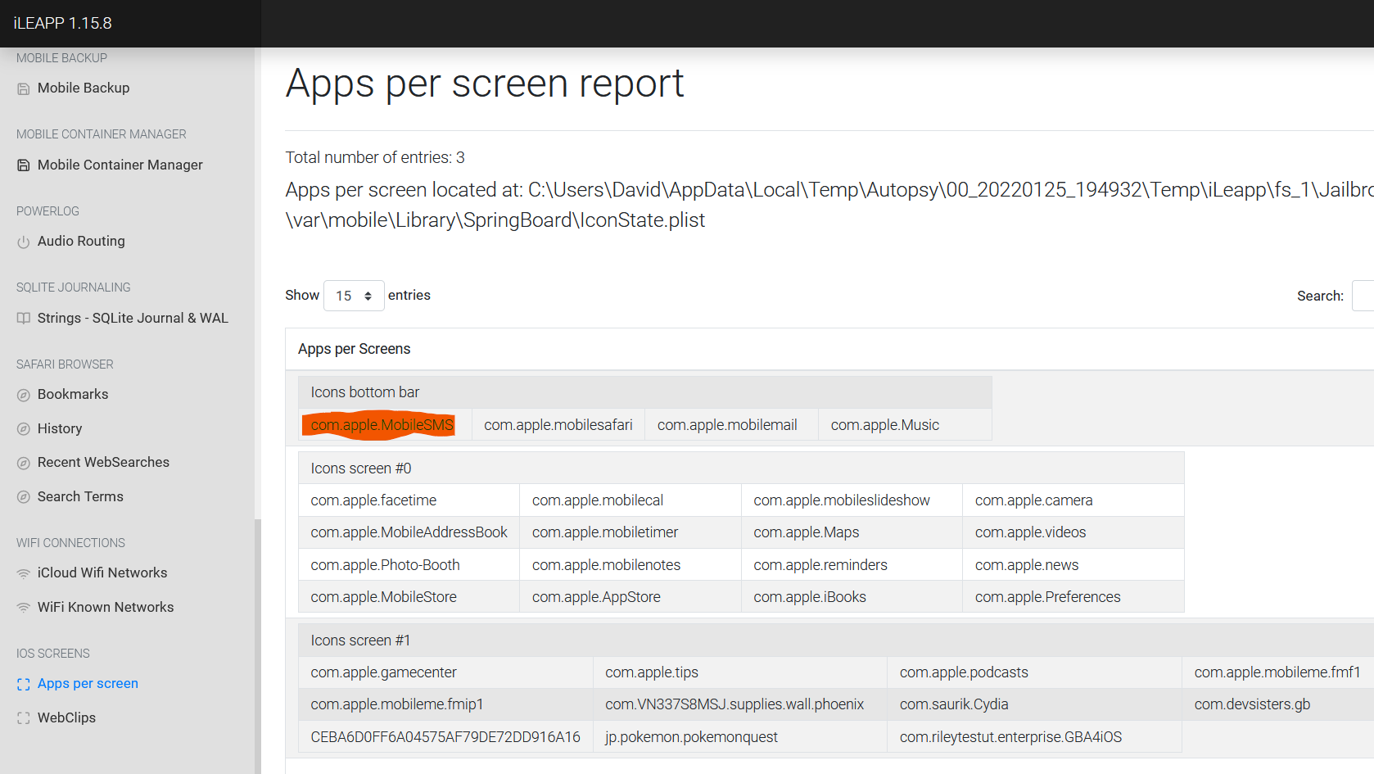

Slide 25
Question 17
A reminder was made to get something, what was it?

Slide 26
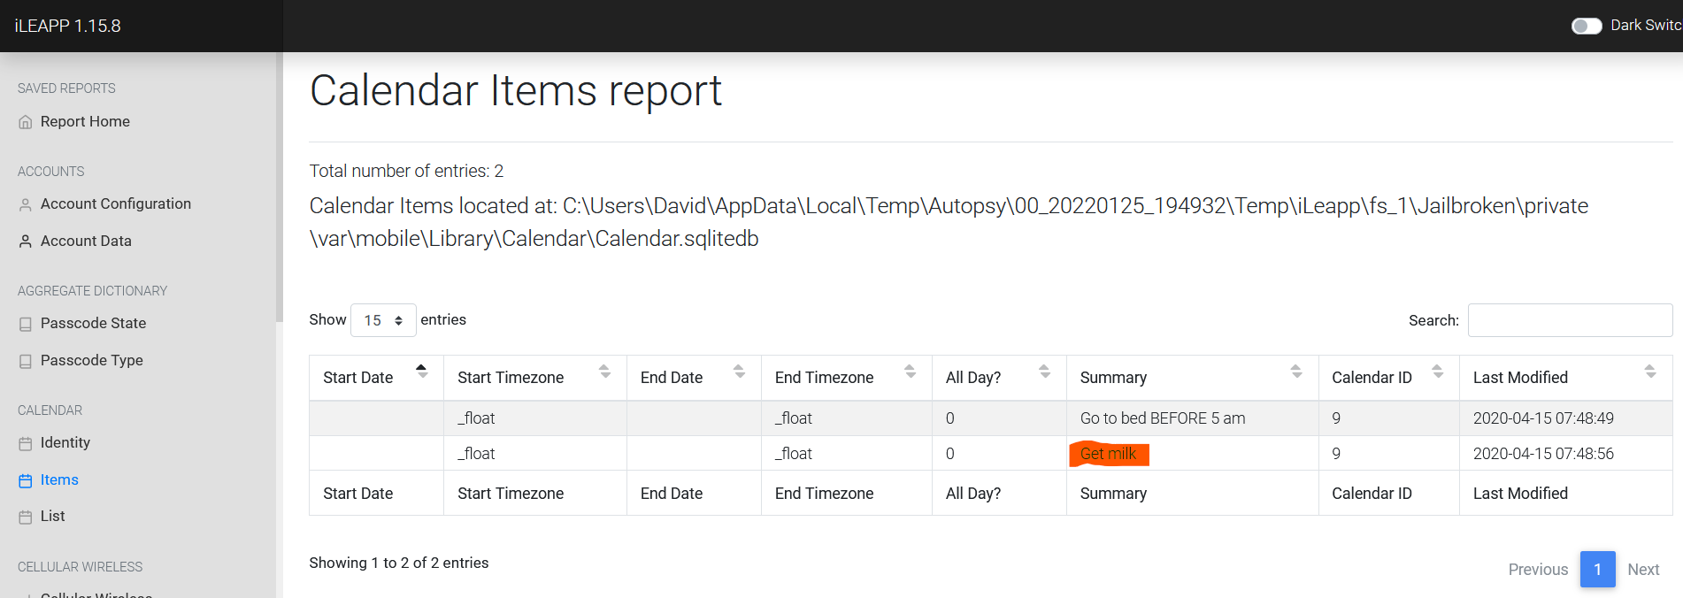

Slide 27

Questions?

